Slide 1



Using UDL principles to promote excellent learning outcomes for all students using Arabic voice

Slide 2

Before we start
This webinar is being recorded and will be available on-demand
Submit questions via the Q&A panel
Participate in polls during the webinar
Interact via the chat function
Notes:
Yassir to please lead and share the housekeeping information. First poll will be added as housekeeping is being discussed.
Ask people to write in the chat where they are hailing from and to say hello in their local language

Slide 3
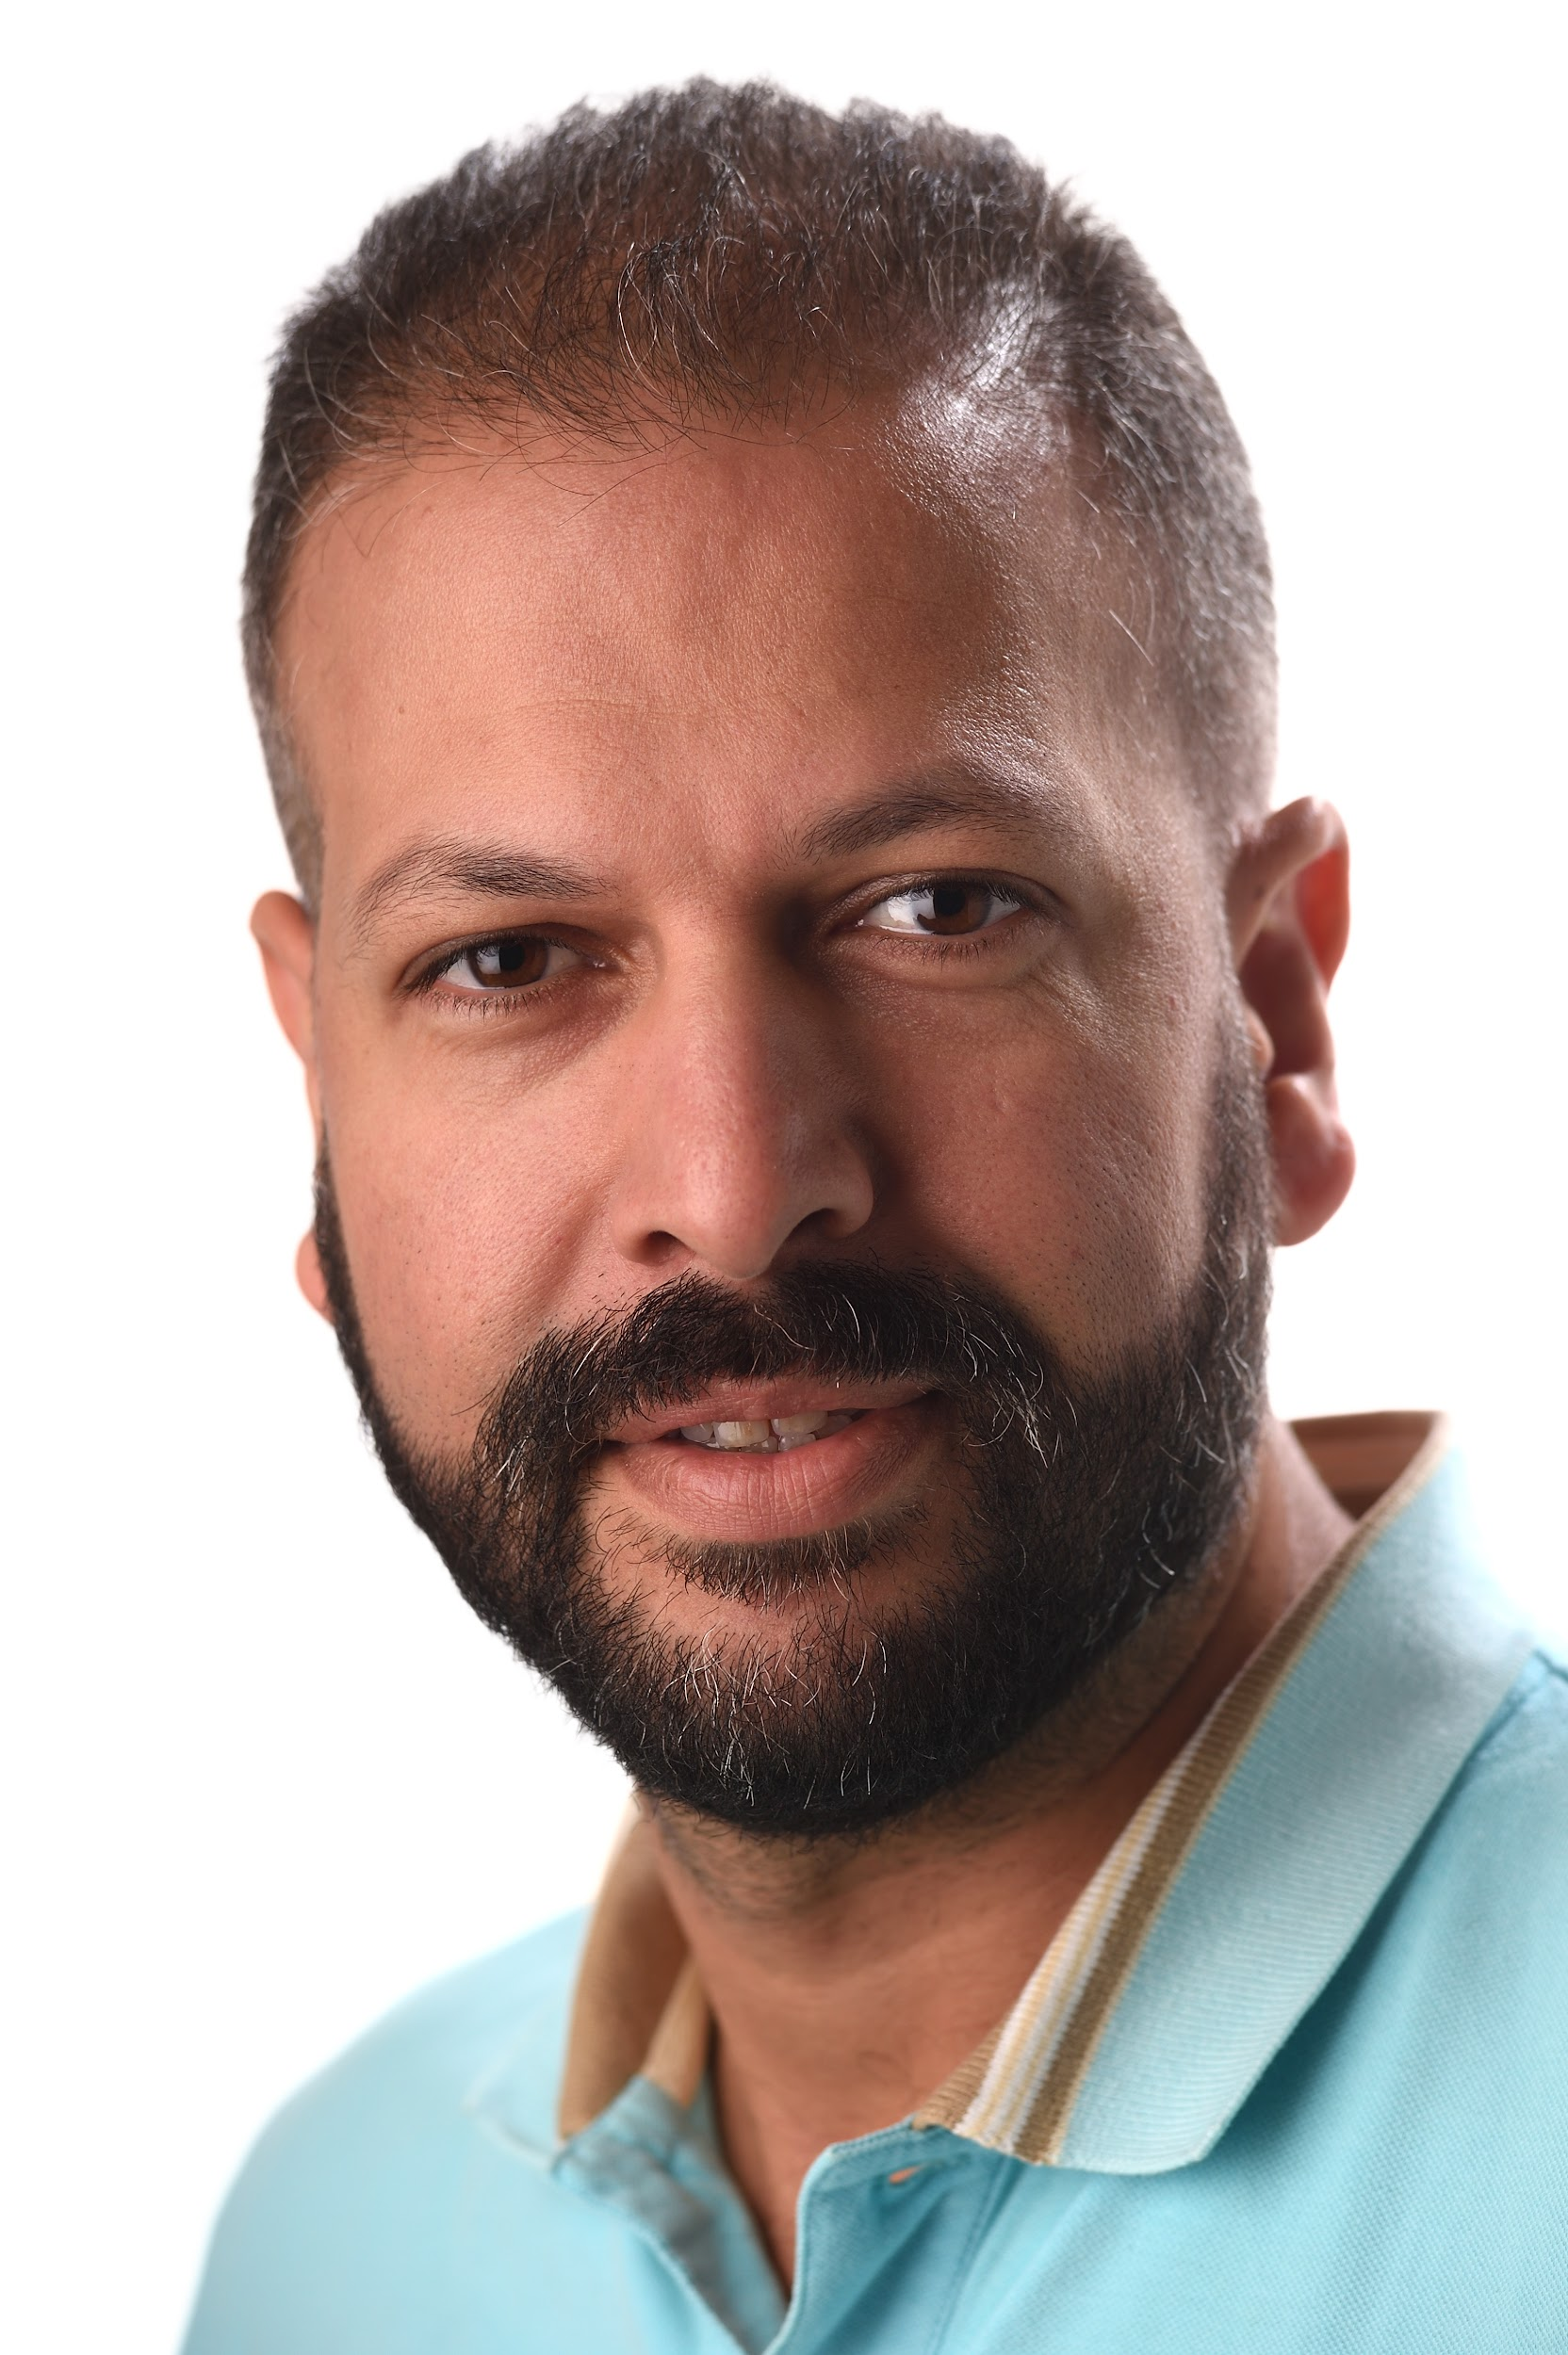
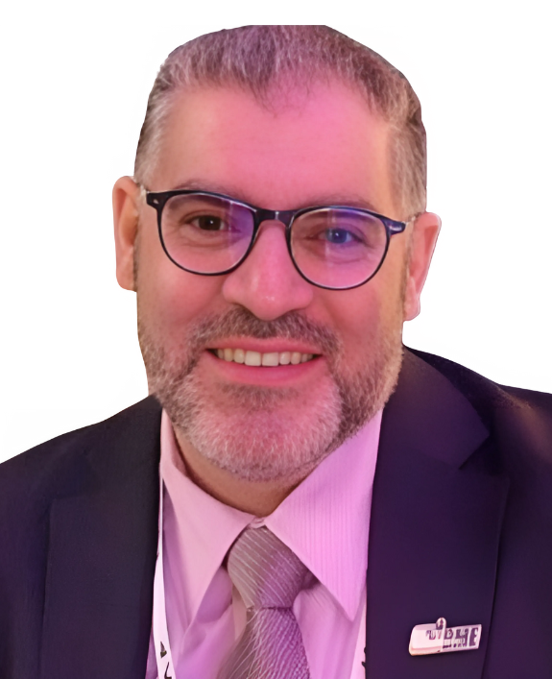
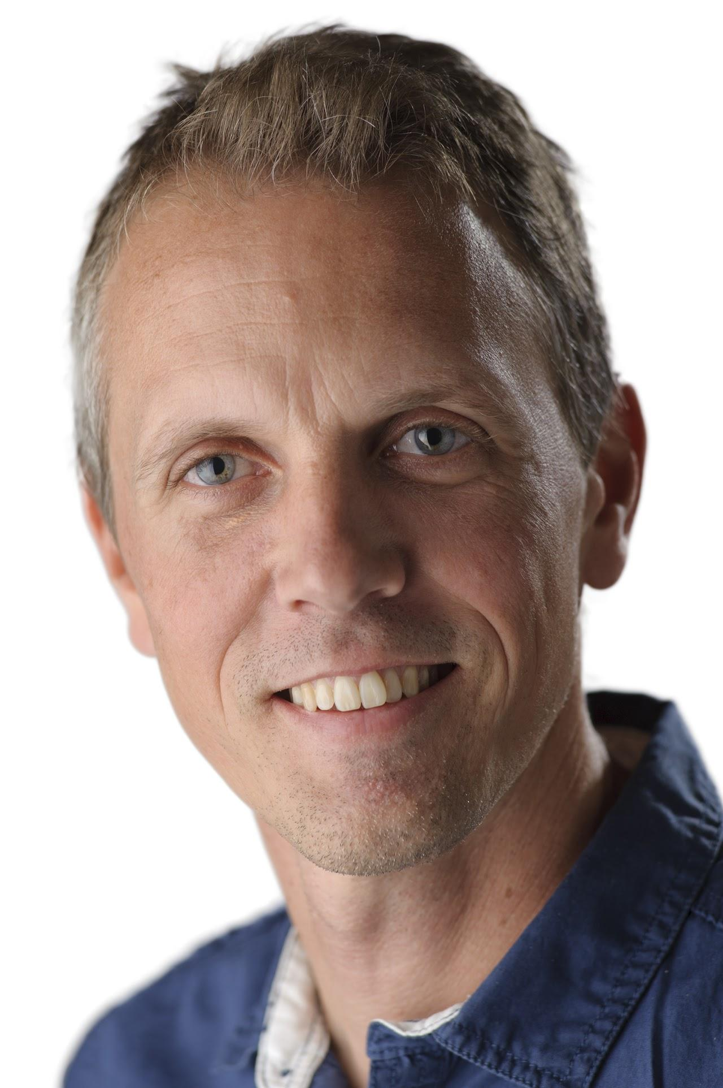

Today’s speakers
Ghanem Numan
Yassir Abassi
Mattias Holman
Notes:
Yassir to introduce himself, then, Ghanmen, then Mattias. Each speaker to give 2 minute introduction to themselves

Slide 4
“Assist educational organisations across the Middle East to build brighter future of students”
“Bring best education with the right technology to those who don’t have access to it”.

Slide 5
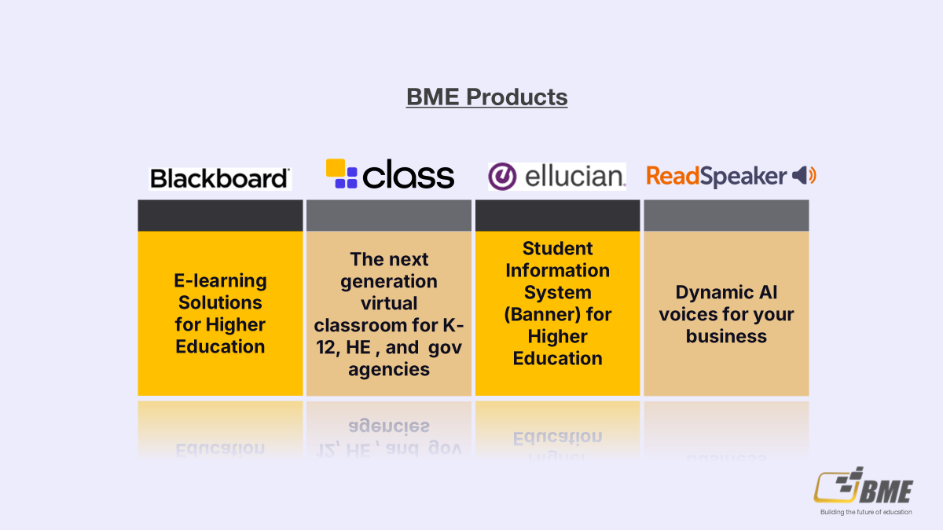
Notes:
Yassir to please lead and share the housekeeping information. First poll will be added as housekeeping is being discussed.
Ask people to write in the chat where they are hailing from and to say hello in their local language

Slide 6
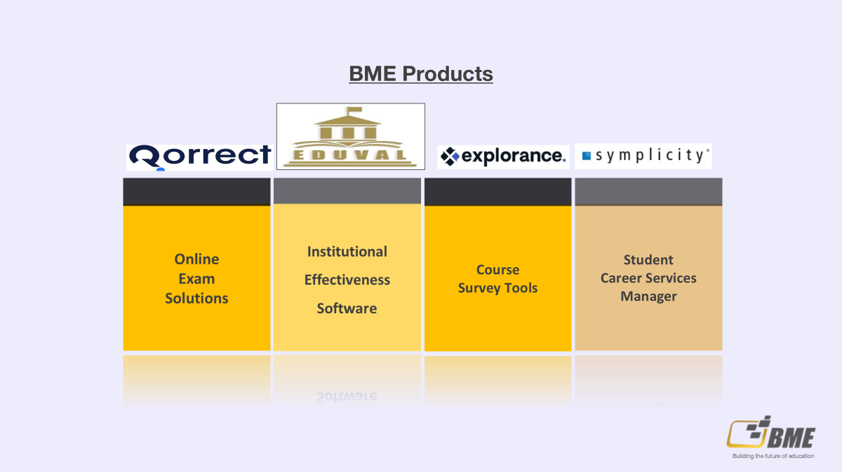
Notes:
Yassir to please lead and share the housekeeping information. First poll will be added as housekeeping is being discussed.
Ask people to write in the chat where they are hailing from and to say hello in their local language

Slide 7

What is UDL?
Notes:
Ghanem

Slide 8
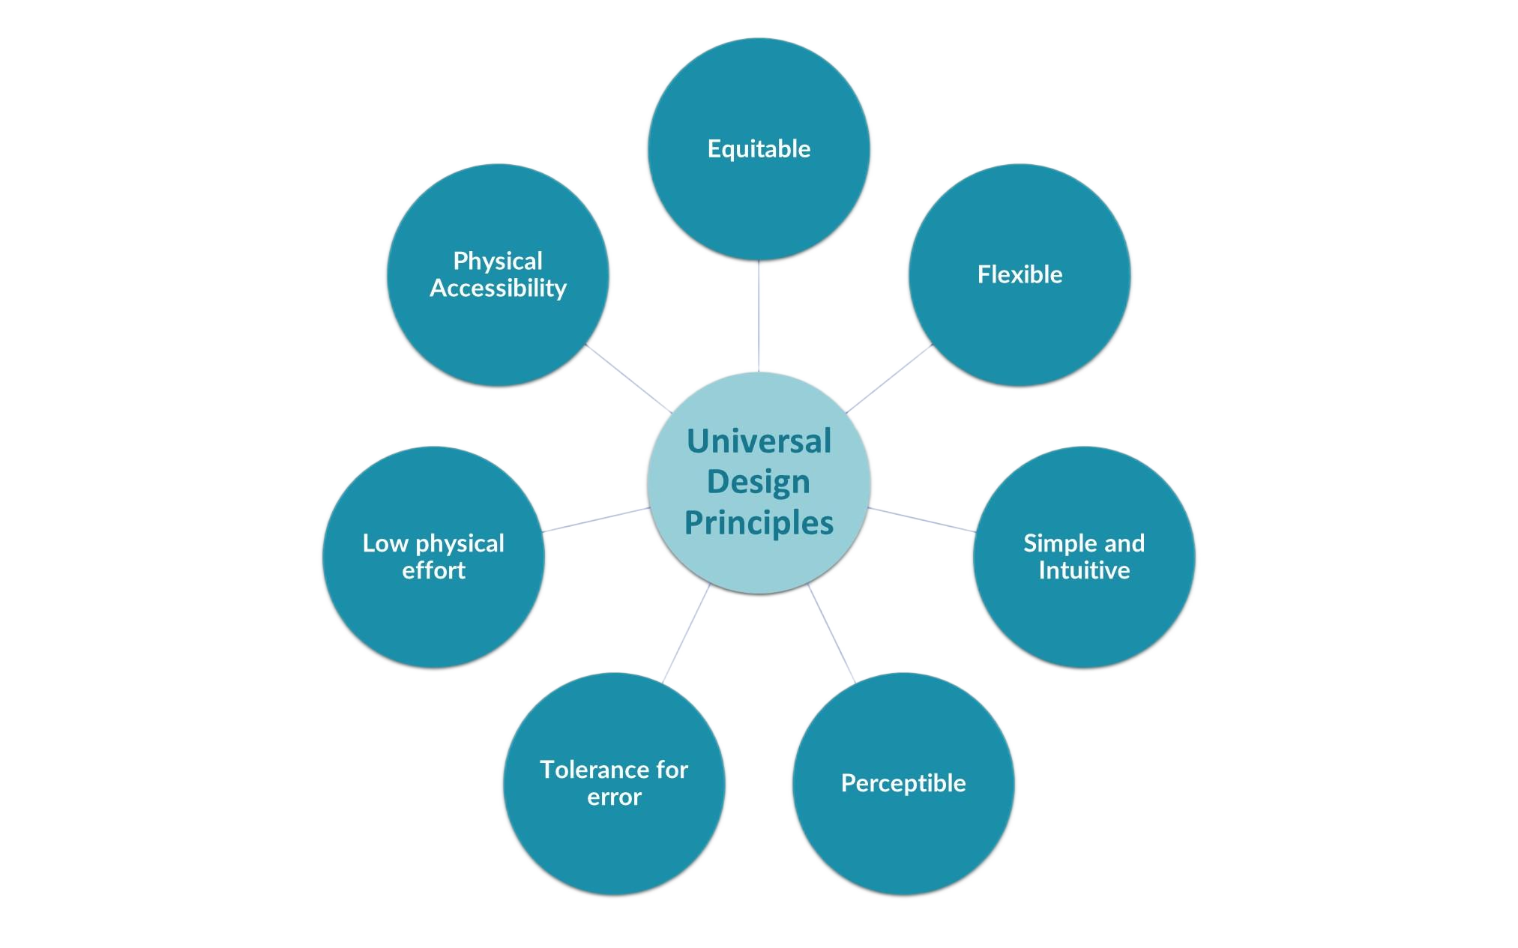

Slide 9

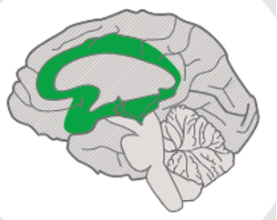
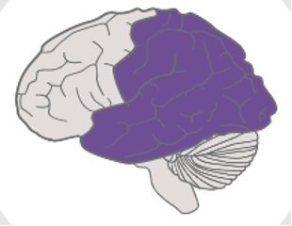
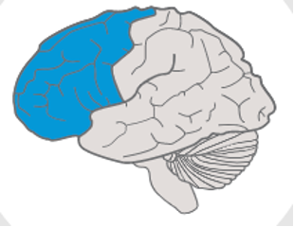
Universal Design for Learning (UDL) principles: An overview
Affective Networks: The “why” of learning | Multiple Means of Engagement: Different ways to encourage excitement and interest in the topic / learning. (e.g., hooks, choices, teamwork)
Recognition Networks: The “what” of learning | Multiple Means of Representation: Present information in different formats (e.g., text, images, audio)
Strategic Networks: The “how” of learning | Multiple Means of Action and Expression: Demonstrate learning in different ways (e.g., writing, speaking, podcasts, videos, drawing).
Notes:
Ghanem: To provide an overview of UDL guidelines, what they mean for educators and learners and why they are important in all learning settings.

Slide 10
UDL in action
Any more relevant for middle east/ case studies
Inclusive education in the UAE: The role of EdTech
Providing equity and inclusion with text-to-speech - Kenya Methodist University
An accessible learning environment that benefits all - Jean Moulin University, Lyon
Text to speech is proven to help High Education Students
Notes:
We can add this article: ReadSpeaker is proven to help higher education students Text to Speech is Proven to Help Higher Education Students It contains good statistics about the case study of the university of Barcelona and I can talk about it

Slide 11
Why UDL?
Notes:
Will share second poll here
Yassir: UDL makes learning more accessible, even in general education classrooms. The UDL framework creates more flexible classroom experiences, meaning that teachers can deliver meaningful learning opportunities to all students

Slide 12
World Health Organization Statistics
Approximately 50-60 million people with disabilities live in the Middle East and North Africa (MENA) region. This represents around 10-12% of the region's population
Source: WHO
Notes:
Yassir: Discuss what this stat means in education - we cannot ignore 12% of the population’s learning needs

Slide 13

Did you know?
40% of students globally don’t access education in a language they understand.
In the GCC, non-nationals account for 52% of the population.
In the UAE, native emirates account for only 13% of the population
x%
40%
52%
13%
Notes:
Yassir: Talk about the importance of students being able to access content in their native language. How can they succeed if they don’t understand properly?

Slide 14
Moving from ‘disability services’ to ‘access for all’
Notes:
Yassir: The world is moving onwards and upwards. Assistive technology can help people with disabilities to access information, communicate, and participate in society. Governments, private organizations, and philanthropists can invest in assistive technology to make it more accessible and affordable for people with disabilities. This can include everything from screen readers and magnifiers to prosthetics and mobility aids.
Education and employment are critical to the well-being and independence of people with disabilities. However, they often face barriers to accessing these opportunities, such as discrimination, lack of accommodations, and insufficient training. Governments, educators, and employers can work together to create more inclusive environments that support people with disabilities in their education and employment goals. This can include providing training and resources for educators and employers, offering reasonable accommodations, and promoting diversity and inclusion in the workplace.
As more and more of our lives move online, it is essential to ensure that digital spaces are accessible to everyone. Websites, apps, and social media platforms should be designed to accommodate people with disabilities, including features such as alternative text for images, closed captions for videos, and keyboard navigation for people who cannot use a mouse.

Slide 15
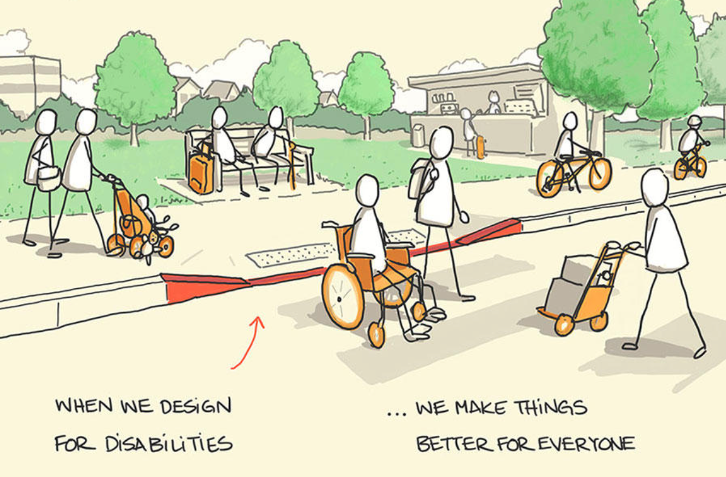
Curb cut effect
Notes:
Yassir: Final visual on how UDL benefits all - explain the image; when you make something accessible for 1 person, it benefits everyone

Slide 16
Text to Speech is an essential element of
Assistive Technology, creating an audio version of content, supporting ALL learners
Notes:
Text-to-speech (TTS) is a type of assistive technology that reads digital text aloud. It’s sometimes called “read aloud” technology.
With a click of a button or the touch of a finger, TTS can take words on a computer or other digital device and convert them into audio. TTS is very helpful for kids and adults who struggle with reading. But it can also help with writing and editing, and even with focusing.

Slide 17

“After a long day, reading gets more demanding, it can be nice to have a tool that reads the text aloud for you. So it’s not only for students who have trouble reading; it’s also for all students who prefer to listen to text instead of reading.”
Notes:
Yassir: Can we get a different quote from a ME customer here?
Unfortunately, Najat Al Saleh did not respond to my emails. We will work with this one

Slide 18

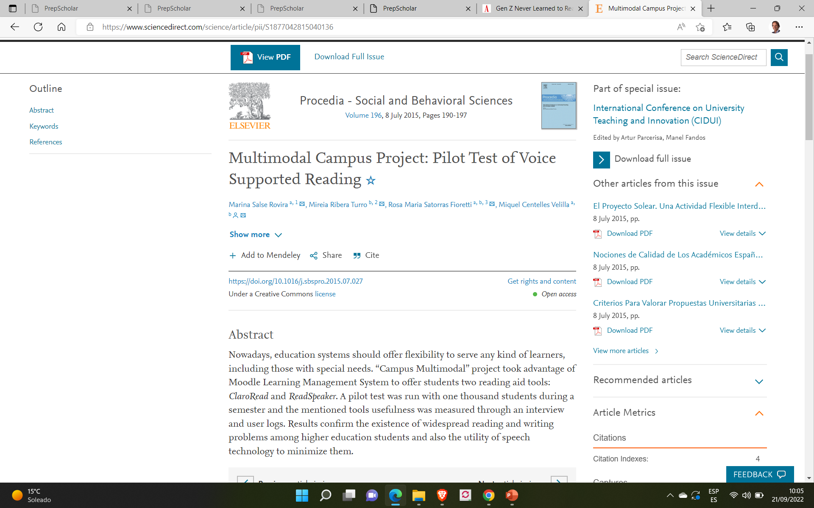
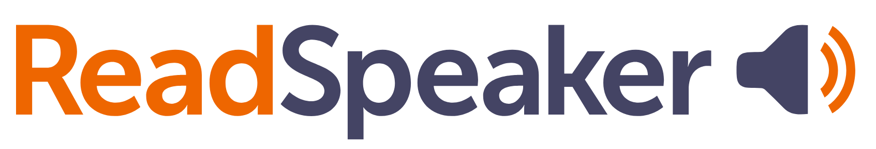

Text to Speech in action
A joint study
20% of Students
Found that Text-To-Speech significantly boosts their focus while engaging with lengthy written materials in their own language.
65% of Students
when the language of choice is English.
Notes:
Yassir: Just to highlight a few examples - this one was a study with Barcelona University Students using Text to Speech

Slide 19



Who benefits from ReadSpeaker Text-To-Speech?
Accessibility
Neurodiverse learners
Dyslexia
Learning disability
Foreign born
Multilingual learners
Cognitive load
Engagement
Bimodal presentation
Comprehension
Inclusion
Online learning
Learning choice
Convenience
Student workload
Teacher workload
All devices
Exam mode
All content types
ENGAGEMENT
Comprehension
Foreign languages
Online learners
Universal Design for Learning
Teaching and learning differently
Vocal assistance for forms
Bi-modal presentation
PTSD
ACCESSIBILITY
20% of the population with:
Limited literacy skills
Visual impairments
Learning disabilities
Dyslexia
Foreign-born
CONVENIENCE
Mobile
Usability
Learning on-the-go
Busy adult and part-time learners
who need to multitask
Personal preference
Learners
Leveraging technology creates a superior
user experience for ALL users
Notes:
Yassir: Discuss here how we support neurodiverse/learning disabilities/non-native speakers but that there are other users who use text-to-speech through choice whether because they find it more engaging or more convenient.
Provides translation and pronunciation support - perfect for EAL
Improves reading fluency
Improves comprehension and retention
Gives an alternative way to access information

Slide 20

ReadSpeaker can be used by ALL learners

Slide 21

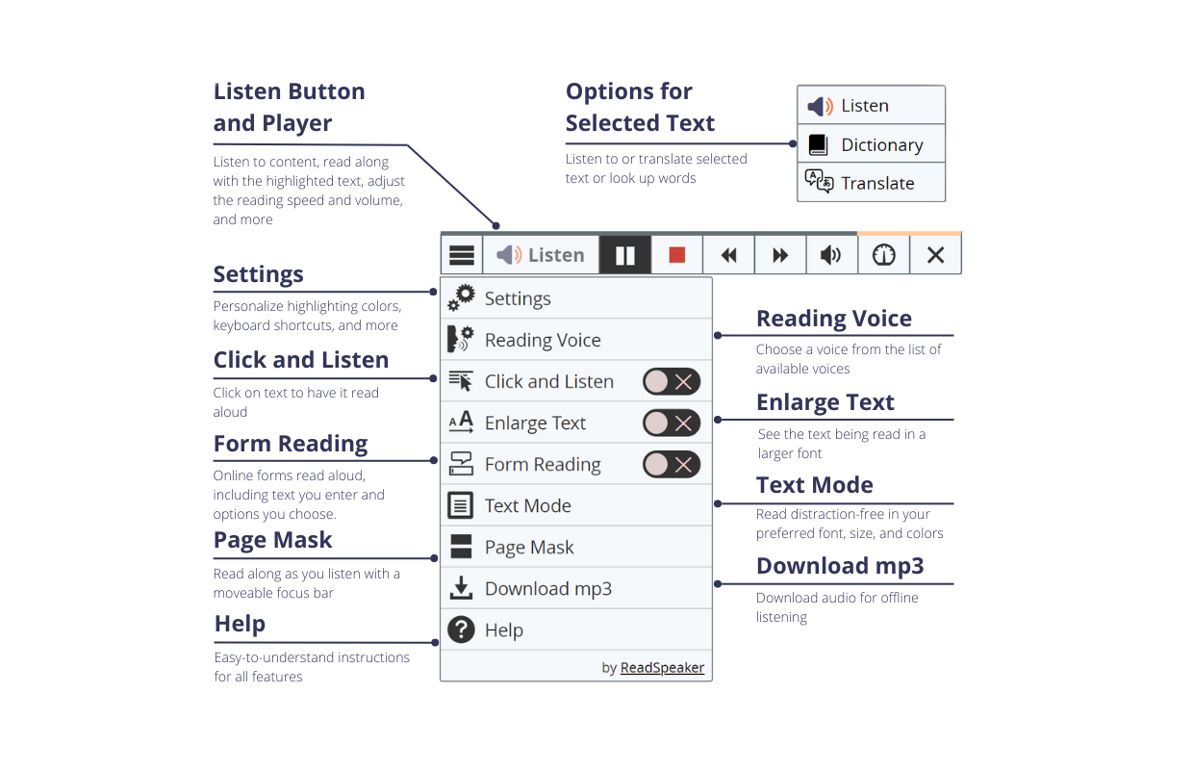
Listen with one click
200 + voices, 50 + languages
Speech-enhanced learning tools
Assessment and accommodations support
Access to usage statistics
WCAG, GDPR compliant
Easy integration
Experienced support team
Notes:
Yassir: Give some more details about ReadSpeaker here, including arabic voices

Slide 22

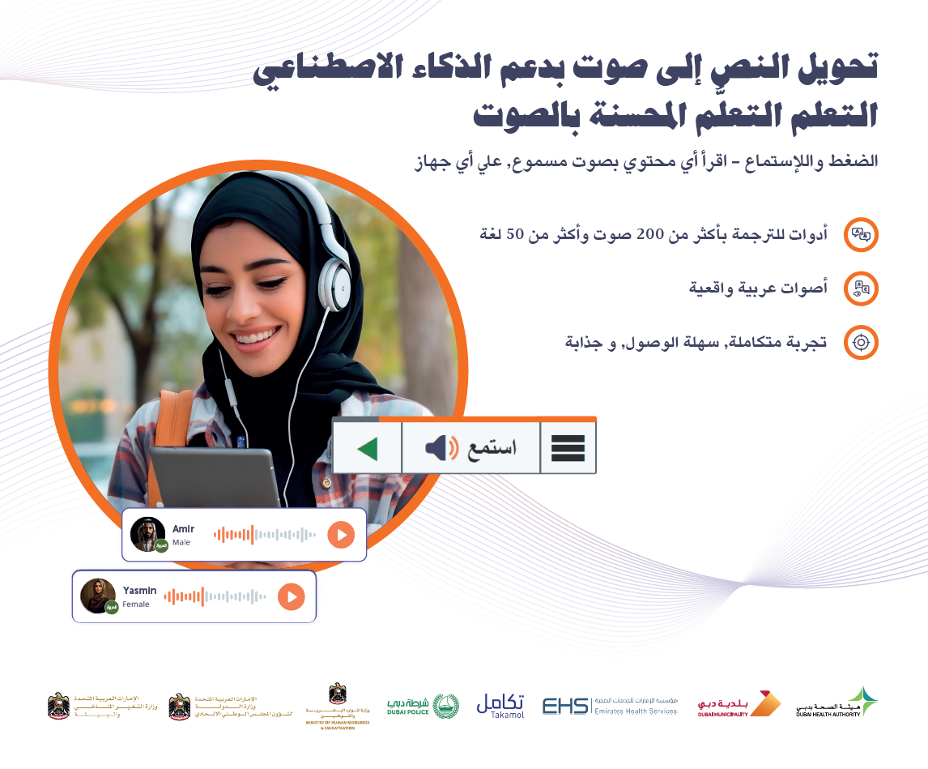



LMS integration
King Faisal University & Princess Nourah bint Abdulrahman University
Notes:
Yassir: Explain the partnership with King Faisal University - this is a great example of an LMS integration for the benefit of all students, using Blackboard

Slide 23
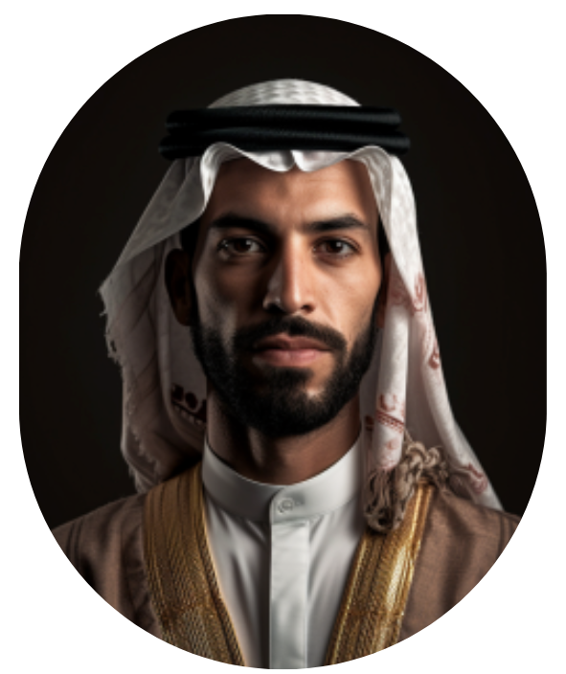
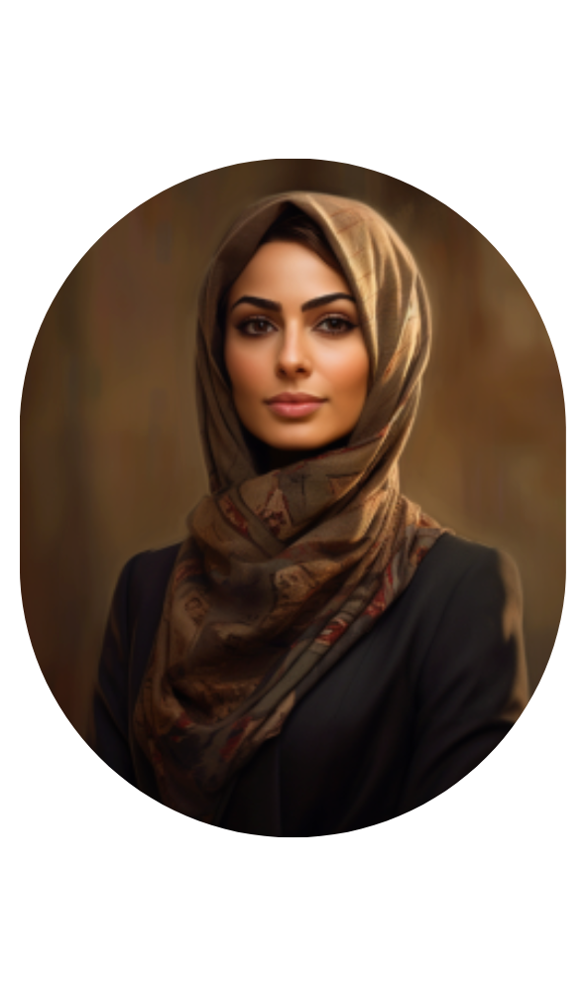


ReadSpeaker Arabic Voices
Amir - أمير
Yasmin - ياسمين

Slide 24
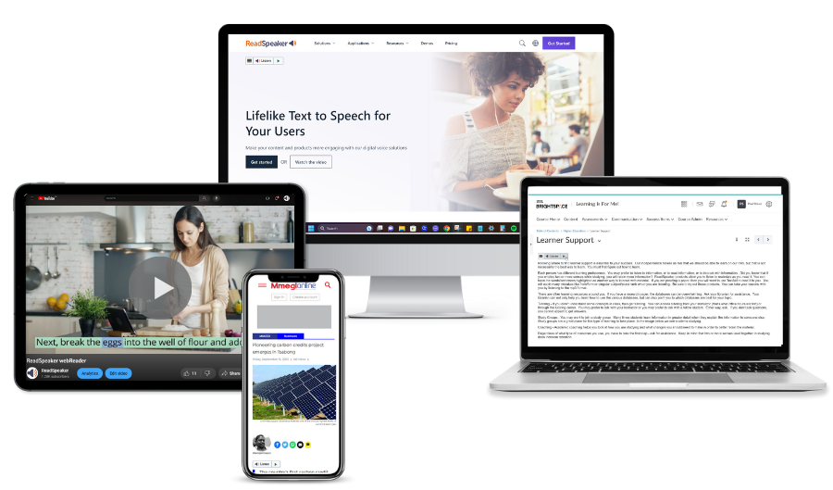
Live Demo
Notes:
Mattias to demo ReadSpeaker - highlight the text-to-speech but also the associated accessibility tools.

Slide 25
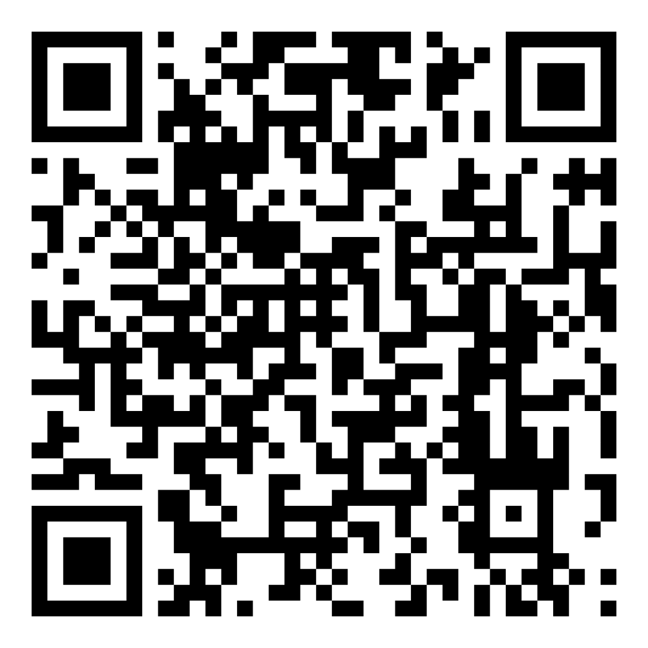
Contact us for more information or to set up a demo
Q&A
Notes:
Yassir/ Ghanem to facilitate Q&A

